Slide 1
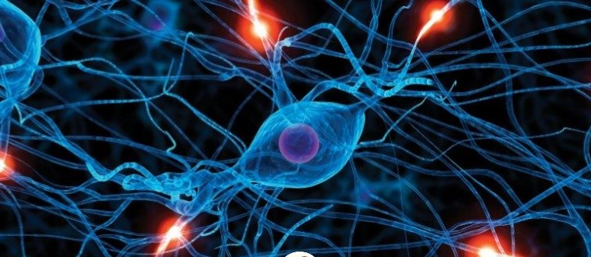
Intro to the World where Machines learn
Tushika Singh
21-09-2020

Slide 2
Outline
Machine Learning basics
Introduction to Deep Learning
What is Deep Learning
Why is it useful
Main components/hyper-parameters:
Activation functions
Optimizers, cost functions and training
Regularization methods
Classification vs. regression tasks
DNN basic architecture of CNN
Most material from CS224 NLP with DL course at Stanford

Slide 3
Machine Learning Basics
Machine learning is a field of computer science that gives computers the ability to learn without being explicitly programmed
Labeled Data
Machine Learning algorithm
Training
Prediction
Labeled Data
Learned model
Prediction
Methods that can learn from and make predictions on data

Slide 4
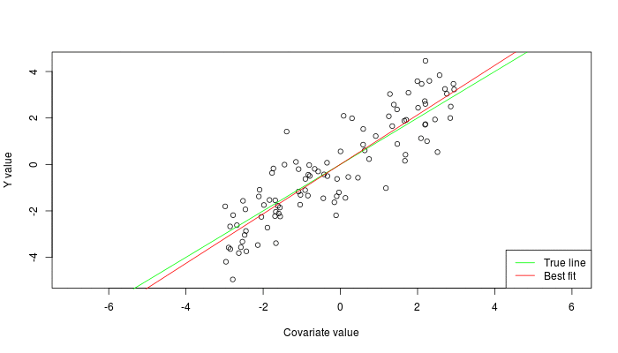


Types of Learning
Supervised: Learning with a labeled training set
Example: email classification with already labeled emails
Unsupervised: Discover patterns in unlabeled data
Example: cluster similar documents based on text
Reinforcement learning: learn to act based on feedback/reward
Example: learn to play Go, reward: win or lose
class A
class A
Classification
Regression
Clustering
Anomaly Detection
Sequence labeling
…
http://mbjoseph.github.io/2013/11/27/measure.html

Slide 5
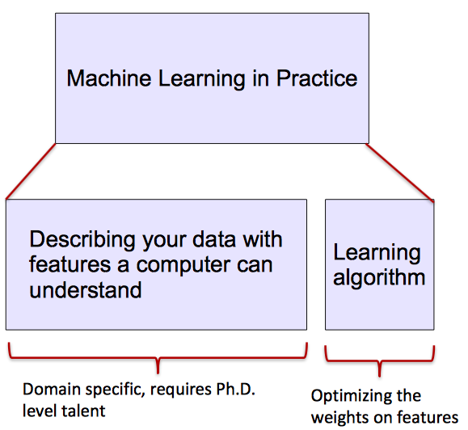
ML vs. Deep Learning
Most machine learning methods work well because of human-designed representations and input features
ML becomes just optimizing weights to best make a final prediction

Slide 6

What is Deep Learning (DL) ?
A machine learning subfield of learning representations of data. Exceptional effective at learning patterns.
Deep learning algorithms attempt to learn (multiple levels of) representation by using a hierarchy of multiple layers
If you provide the system tons of information, it begins to understand it and respond in useful ways.
https://www.xenonstack.com/blog/static/public/uploads/media/machine-learning-vs-deep-learning.png

Slide 7
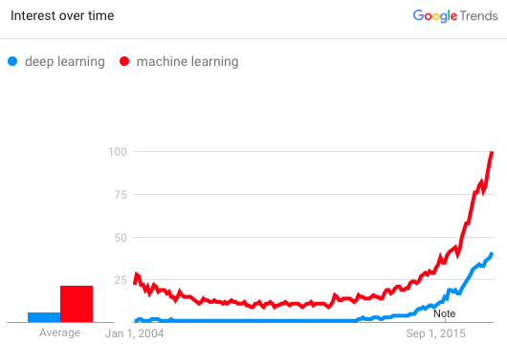
Why is DL useful?
Manually designed features are often over-specified, incomplete and take a long time to design and validate
Learned Features are easy to adapt, fast to learn
Deep learning provides a very flexible, (almost?) universal, learnable framework for representing world, visual and linguistic information.
Can learn both unsupervised and supervised
Effective end-to-end joint system learning
Utilize large amounts of training data
In ~2010 DL started outperforming other ML techniques
first in speech and vision, then NLP

Slide 8
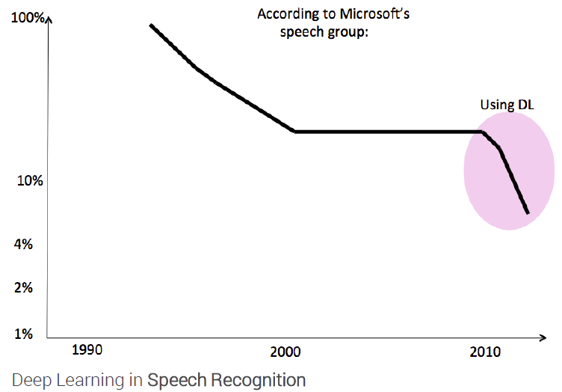
State of the art in …
Several big improvements in recent years in NLP
Machine Translation
Sentiment Analysis
Dialogue Agents
Question Answering
Text Classification …

Slide 9
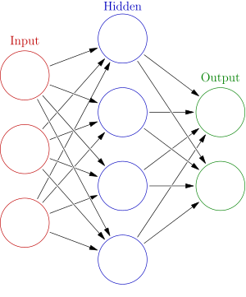


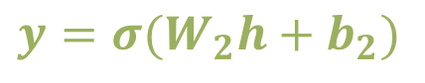
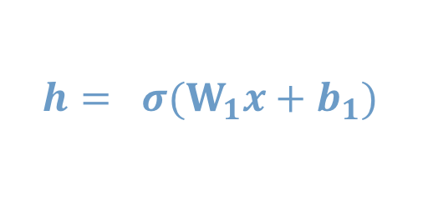

Neural Network Intro
Weights
$$h= σ(W_{1}x+b_{1})$$
$$y=σ(W_{2}h+b_{2})$$
Activation functions
How do we train?
$$y$$
$$x$$
4 + 2 = 6 neurons (not counting inputs)
[3 x 4] + [4 x 2] = 20 weights
4 + 2 = 6 biases
26 learnable parameters
$$h$$
Demo
Notes:
Hyper-parameters

Slide 10

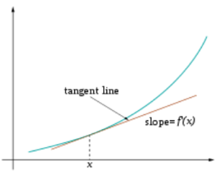
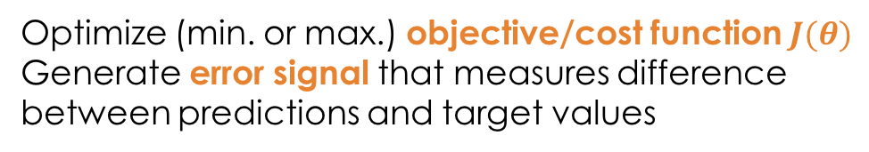
Training
Sample labeled data
(batch)
Forward it through the network, get predictions
Back-propagate the errors
Update the network weights
Optimize (min. or max.) objective/cost function $J(θ)$
Generate error signal that measures difference between predictions and target values
Use error signal to change the weights and get more accurate predictions
Subtracting a fraction of the gradient moves you towards the (local) minimum of the cost function
https://medium.com/@ramrajchandradevan/the-evolution-of-gradient-descend-optimization-algorithm-4106a6702d39

Slide 11
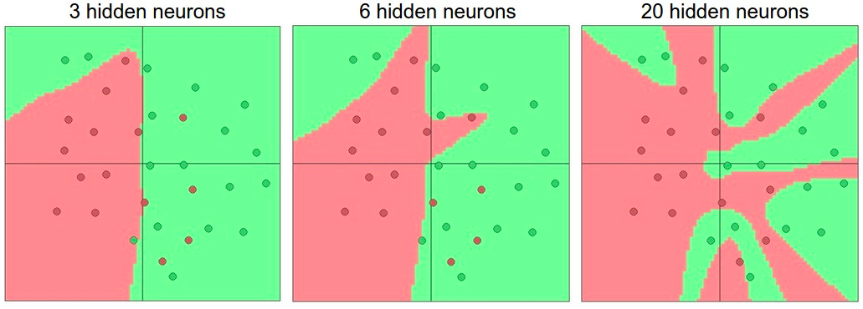
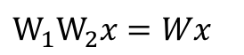
Activation functions
Non-linearities needed to learn complex (non-linear) representations of data, otherwise the NN would be just a linear function
More layers and neurons can approximate more complex functions
$W_{1}W_{2}x=Wx$
http://cs231n.github.io/assets/nn1/layer_sizes.jpeg
Full list: https://en.wikipedia.org/wiki/Activation_function

Slide 12
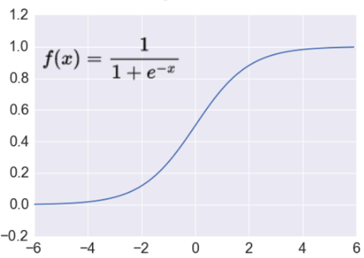
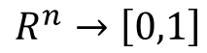
Activation: Sigmoid
Takes a real-valued number and “squashes” it into range between 0 and 1.
$$R^{n}→\left[0,1\right]$$
http://adilmoujahid.com/images/activation.png

Slide 13
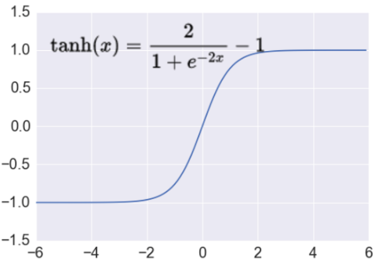
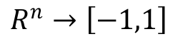
Activation: Tanh
Takes a real-valued number and “squashes” it into range between -1 and 1.
$$R^{n}→\left[−1,1\right]$$
http://adilmoujahid.com/images/activation.png
Notes:
not zero-centered: later layers of processing would be receiving data that is not zero-centered.
if data coming into a neuron is always positive then the gradient on the weights will be either all be positive, or all negative (depending on the gradient of the whole expression). Could introduce undesirable zig-zagging dynamics in the gradient weight updates. However, once these gradients are added up across a data batch the final weight update can have variable signs, somewhat mitigating this issue.

Slide 14
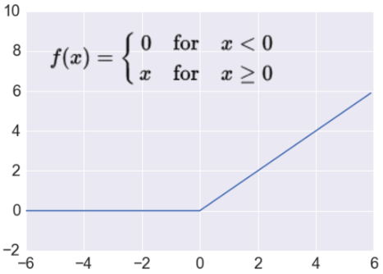
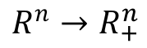
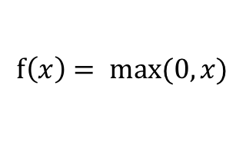
Activation: ReLU
Takes a real-valued number and thresholds it at zero
$$f\left(x\right)= max⁡(0,x)$$
$$R^{n}→R_{+}^{n}$$
http://adilmoujahid.com/images/activation.png
Notes:
ReLU units can “die”
large gradient flowing through a ReLU could cause weights to update in such a way that the neuron will never activate on any datapoint again
gradient flowing through the unit will forever be zero from that point on
With a proper setting of the learning rate this is less frequently an issue

Slide 15
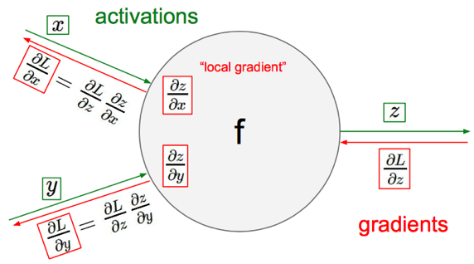
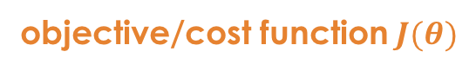
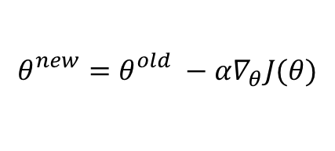
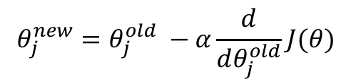
Gradient Descent
objective/cost function $J(θ)$
Review of backpropagation
$$θ_{j}^{new}=θ_{j}^{old} −α\frac{ⅆ}{ⅆθ_{j}^{old}}J(θ)$$
Update each element of θ
$$θ_{}^{new}=θ_{}^{old} −α∇_{θ}J(θ)$$
Matrix notation for all parameters
learning rate
Recursively apply chain rule though each node
Notes:
Adaptive Gradient Algorithm (AdaGrad) that maintains a per-parameter learning rate that improves performance on problems with sparse gradients (e.g. natural language and computer vision problems).
Root Mean Square Propagation (RMSProp) that also maintains per-parameter learning rates that are adapted based on the average of recent magnitudes of the gradients for the weight (e.g. how quickly it is changing). This means the algorithm does well on online and non-stationary problems (e.g. noisy).
Adam realizes the benefits of both AdaGrad and RMSProp.
Instead of adapting the parameter learning rates based on the average first moment (the mean) as in RMSProp, Adam also makes use of the average of the second moments of the gradients (the uncentered variance).
Specifically, the algorithm calculates an exponential moving average of the gradient and the squared gradient, and the parameters beta1 and beta2 control the decay rates of these moving averages.
The initial value of the moving averages and beta1 and beta2 values close to 1.0 (recommended) result in a bias of moment estimates towards zero. This bias is overcome by first calculating the biased estimates before then calculating bias-corrected estimates.

Slide 16
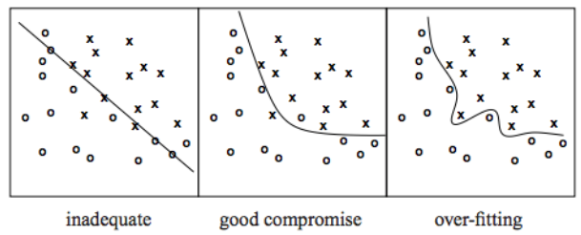
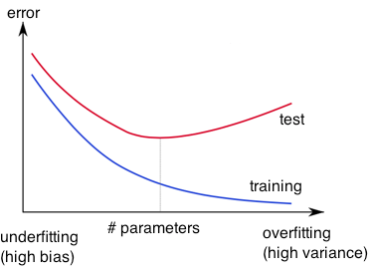
Overfitting
http://wiki.bethanycrane.com/overfitting-of-data
Learned hypothesis may fit the training data very well, even outliers (noise) but fail to generalize to new examples (test data)
https://www.neuraldesigner.com/images/learning/selection_error.svg

Slide 17
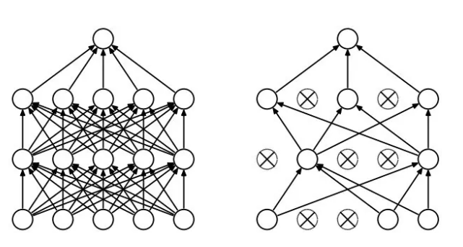
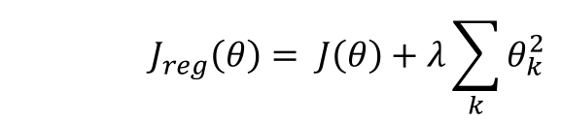
Regularization
Dropout
Randomly drop units (along with their connections) during training
Each unit retained with fixed probability p, independent of other units
Hyper-parameter p to be chosen (tuned)
L2 = weight decay
Regularization term that penalizes big weights, added to the objective
Weight decay value determines how dominant regularization is during gradient computation
Big weight decay coefficient → big penalty for big weights
$$J_{reg}\left(θ\right)= J\left(θ\right)+λ\sum_{k}{θ_{k}^{2}}$$
Early-stopping
Use validation error to decide when to stop training
Stop when monitored quantity has not improved after n subsequent epochs
n is called patience

Slide 18
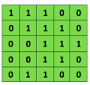

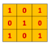
Convolutional Neural Networks (CNNs)
Main CNN idea for text:
Compute vectors for n-grams and group them afterwards
Example: “this takes too long” compute vectors for:
This takes, takes too, too long, this takes too, takes too long, this takes too long
Convolutional
3x3 filter
Input matrix
http://deeplearning.stanford.edu/wiki/index.php/Feature_extraction_using_convolution
Notes:
http://www.asimovinstitute.org/neural-network-zoo/

Slide 19
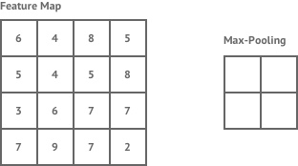
Convolutional Neural Networks (CNNs)
Main CNN idea for text:
Compute vectors for n-grams and group them afterwards
max pool
2x2 filters
and stride 2
https://shafeentejani.github.io/assets/images/pooling.gif

Slide 20
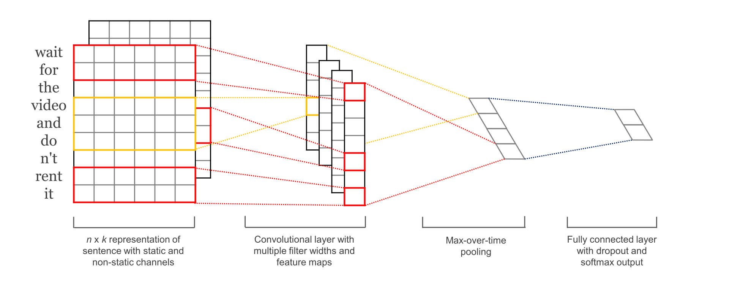
CNN with multiple filters
Kim, Y. “Convolutional Neural Networks for Sentence Classification”, EMNLP (2014)
sliding over 3, 4 or 5 words at a time

Slide 21
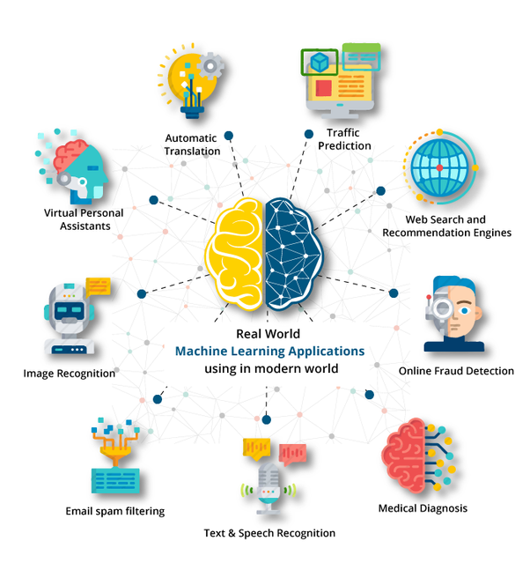

Slide 22
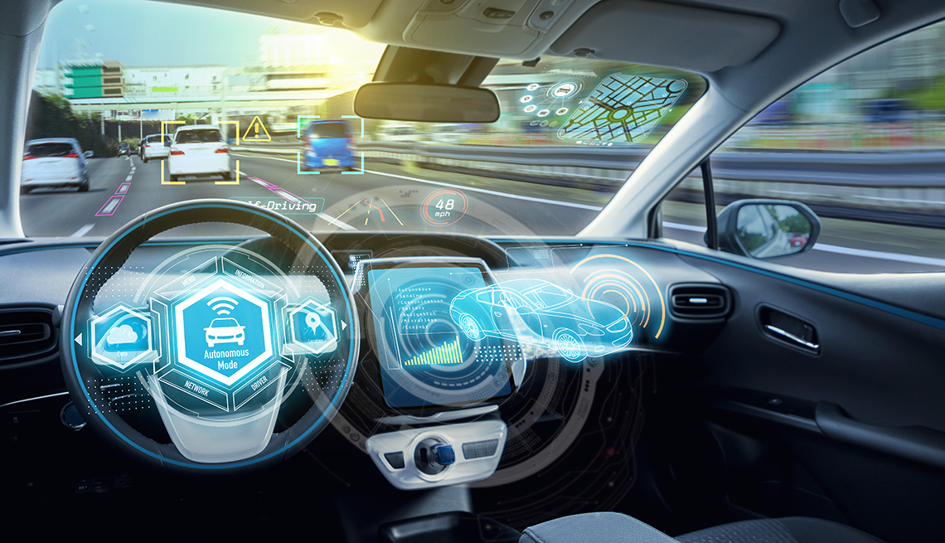
SELF DRIVING CARS

Slide 23
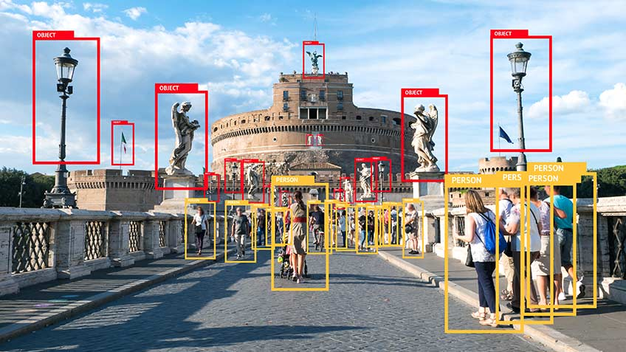

Slide 24
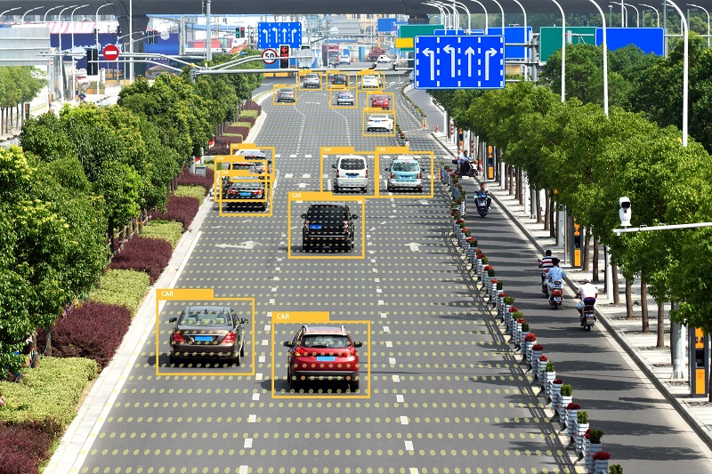

Slide 25
References & Resources
http://web.stanford.edu/class/cs224n
https://www.coursera.org/specializations/deep-learning
https://chrisalbon.com/#Deep-Learning
http://www.asimovinstitute.org/neural-network-zoo
http://cs231n.github.io/optimization-2
https://medium.com/@ramrajchandradevan/the-evolution-of-gradient-descend-optimization-algorithm-4106a6702d39
https://arimo.com/data-science/2016/bayesian-optimization-hyperparameter-tuning
http://www.wildml.com/2015/12/implementing-a-cnn-for-text-classification-in-tensorflow
http://www.wildml.com/2015/11/understanding-convolutional-neural-networks-for-nlp
https://medium.com/technologymadeeasy/the-best-explanation-of-convolutional-neural-networks-on-the-internet-fbb8b1ad5df8
http://www.wildml.com/2015/09/recurrent-neural-networks-tutorial-part-1-introduction-to-rnns/
http://www.wildml.com/2015/10/recurrent-neural-network-tutorial-part-4-implementing-a-grulstm-rnn-with-python-and-theano/
http://colah.github.io/posts/2015-08-Understanding-LSTMs
https://github.com/hyperopt/hyperopt
https://github.com/tensorflow/nmt

Slide 26

https://giphy.com/gifs/thanks-thank-you-thnx-3o6ozuHcxTtVWJJn32/download

